Slide 1

Presenting GSA-BMCC
BMCC

Slide 2
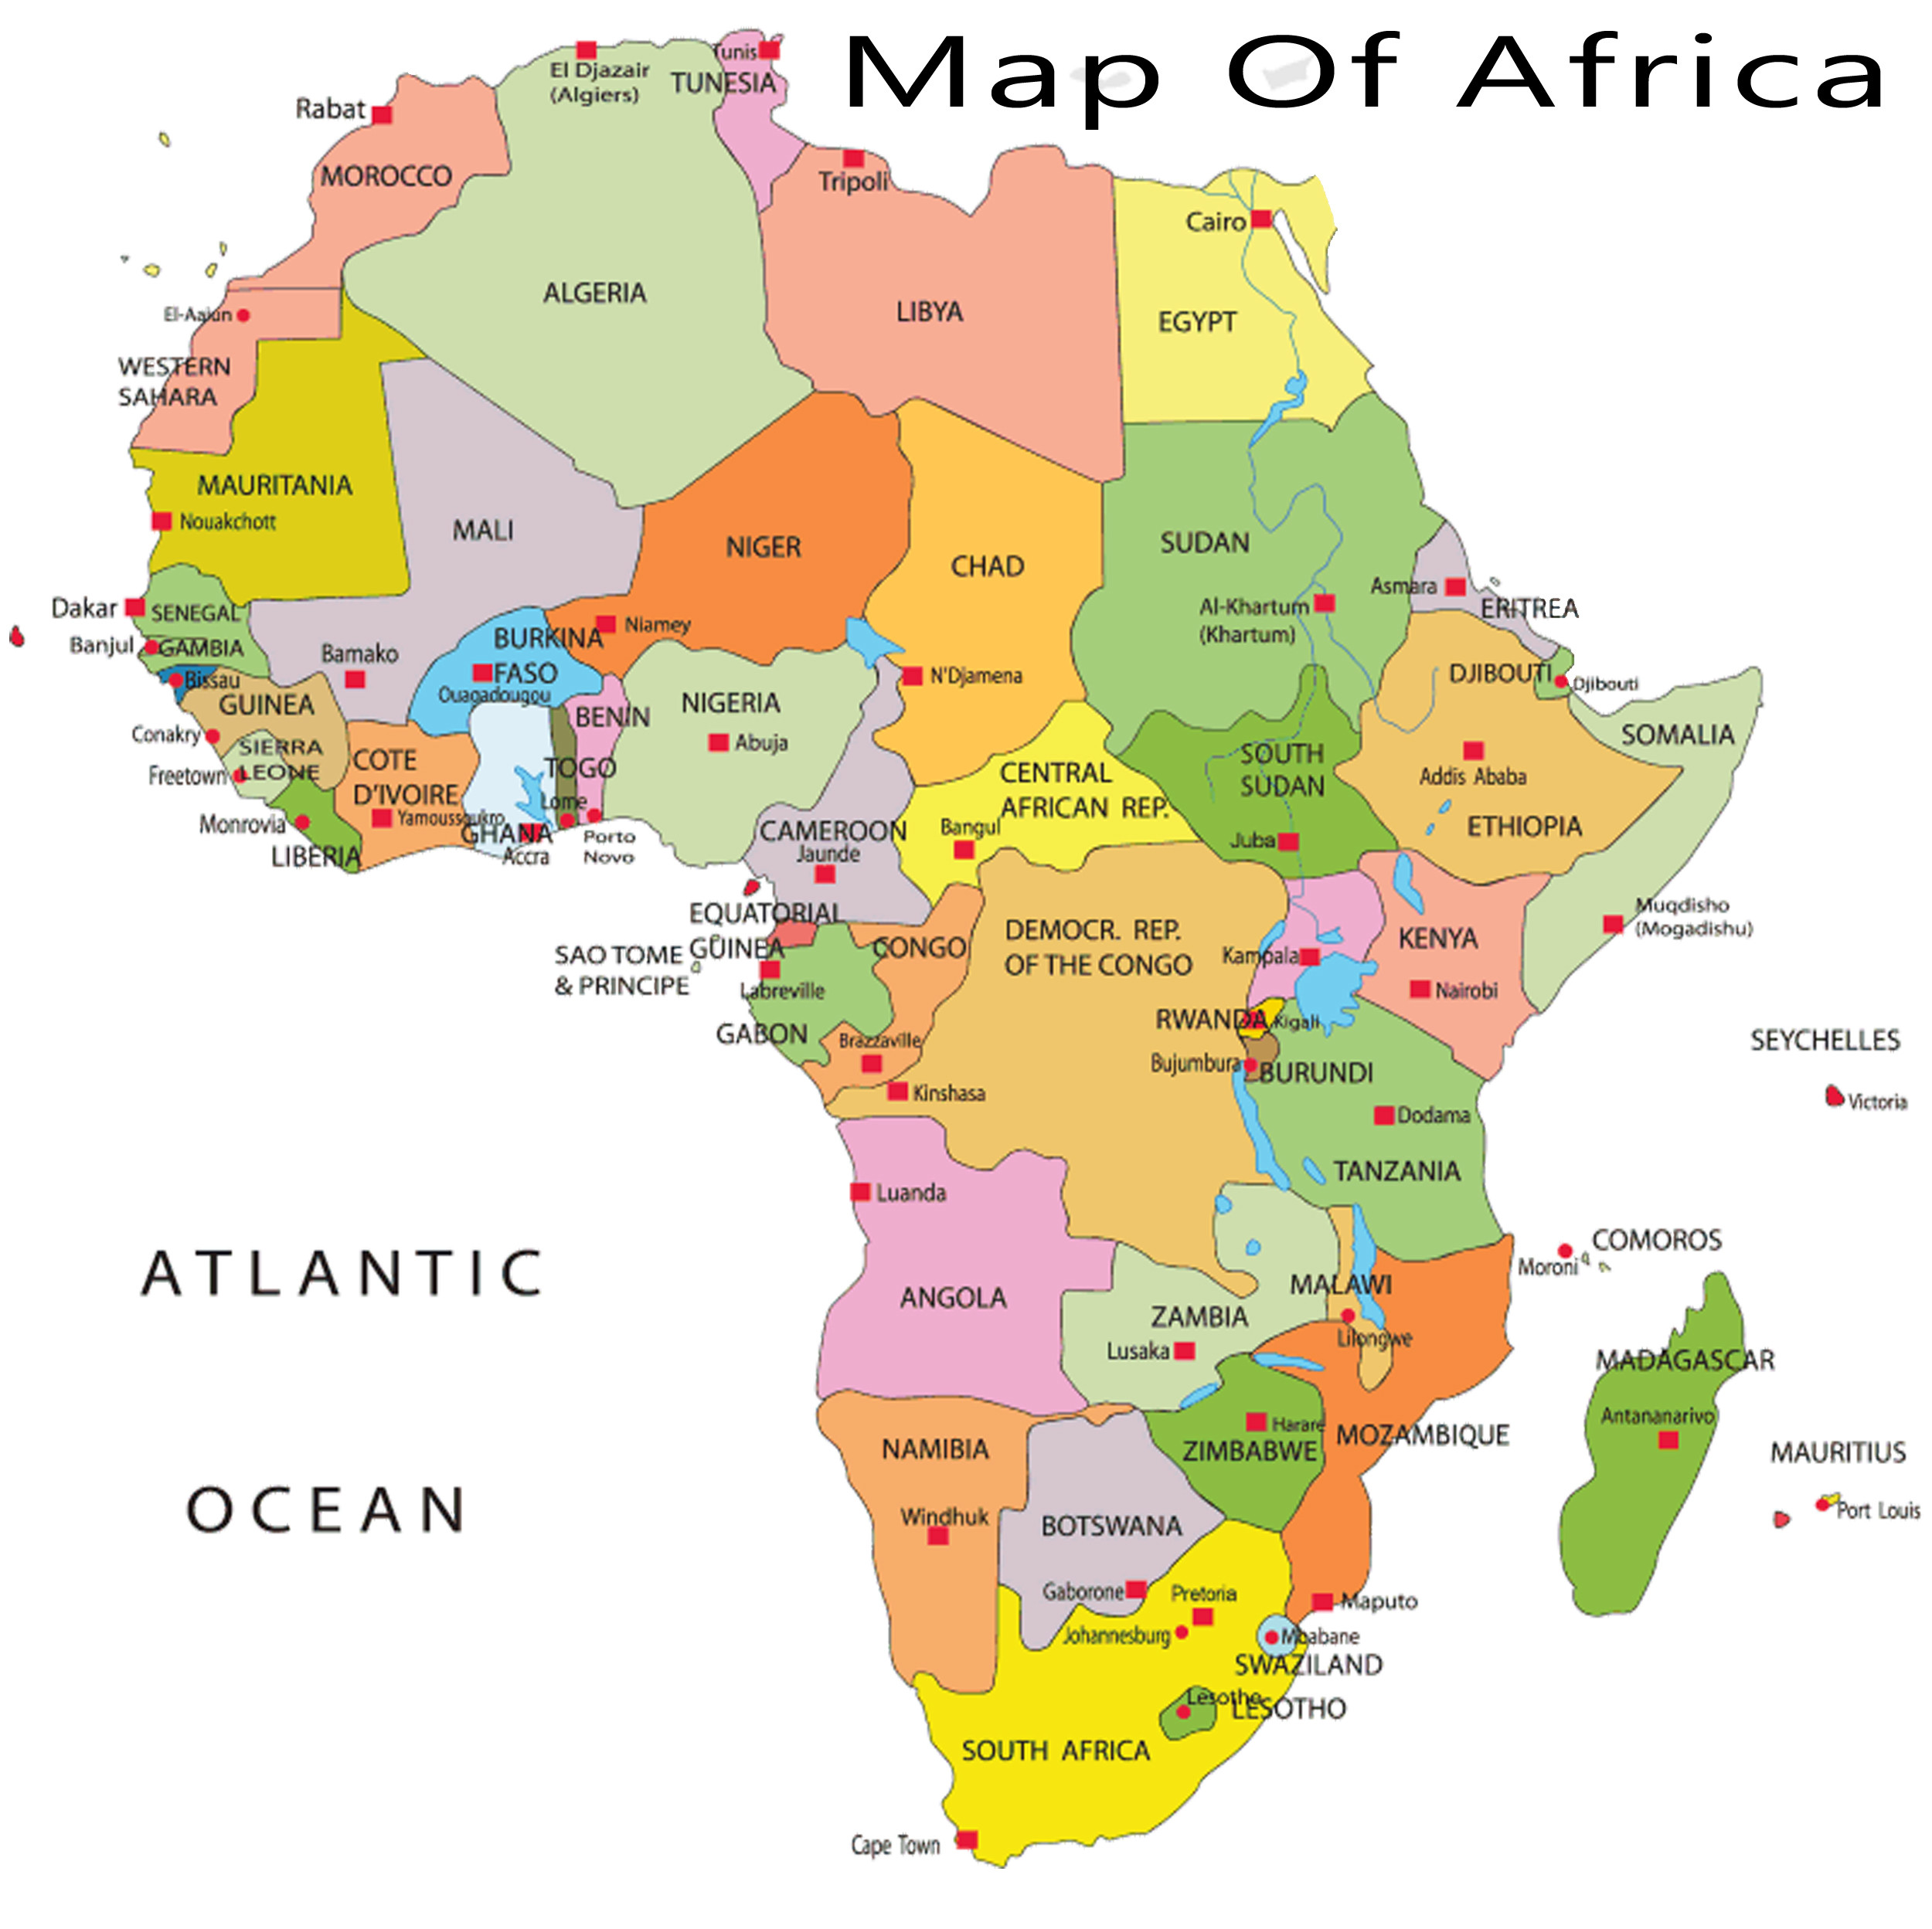

Slide 3


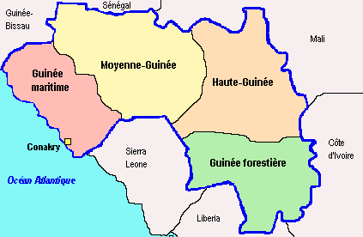
GUINEA
Location: West Africa.
Capital: Conakry.
Flag: Red, Yellow and Green.
National Anthem: Liberty
Motto: Travail, Justice and solidarite.
Composed: Four Regions.

Slide 4
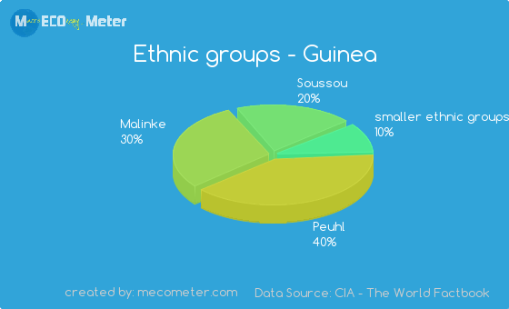
Ethnicities

Slide 5

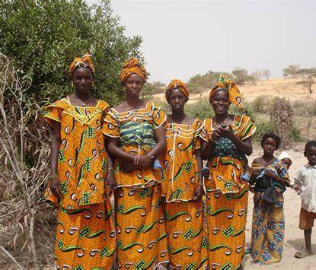
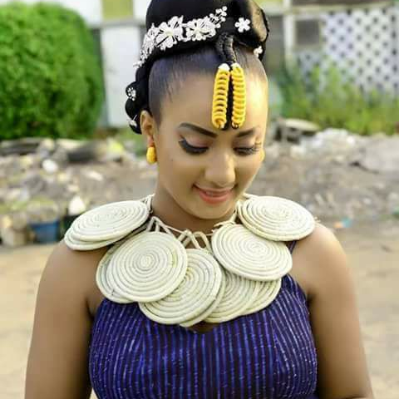
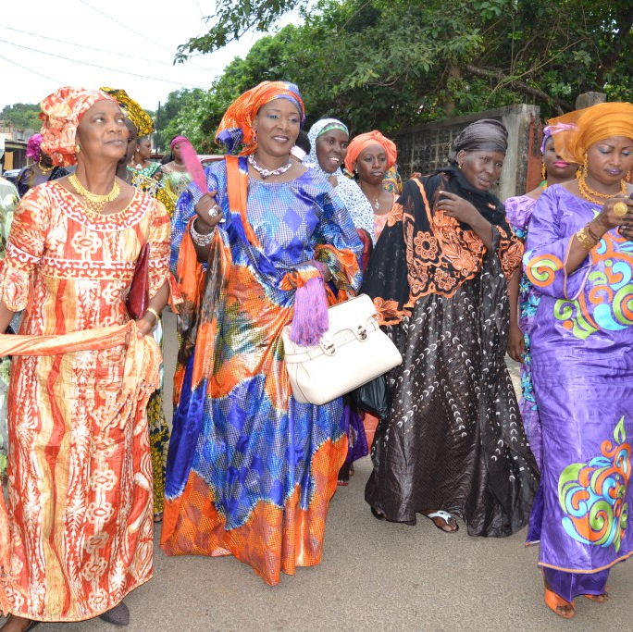
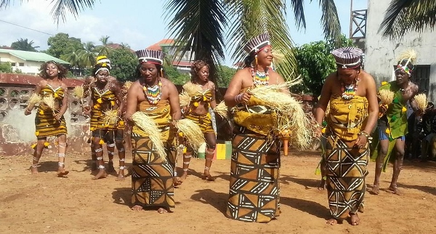
Cultures/Clothing
Guinea cultural clothing comprises of Leppi; Wax; Bazin; and Foret Sacre.

Slide 6
Presenting GSA-BMCC
BMCC

Slide 7
What is GSA?
GSA stands for Guinean Students Association.
This brilliant idea was first introduced by a young Guinean of the name of Abdourahmane Diallo, former student at Baruch College.
The first GSA club/chapter was established at Baruch College over the spring of 2016.

Slide 8
What is GSA Mission Statement?
To inspire and empower the Guinean Community through education.

Slide 9
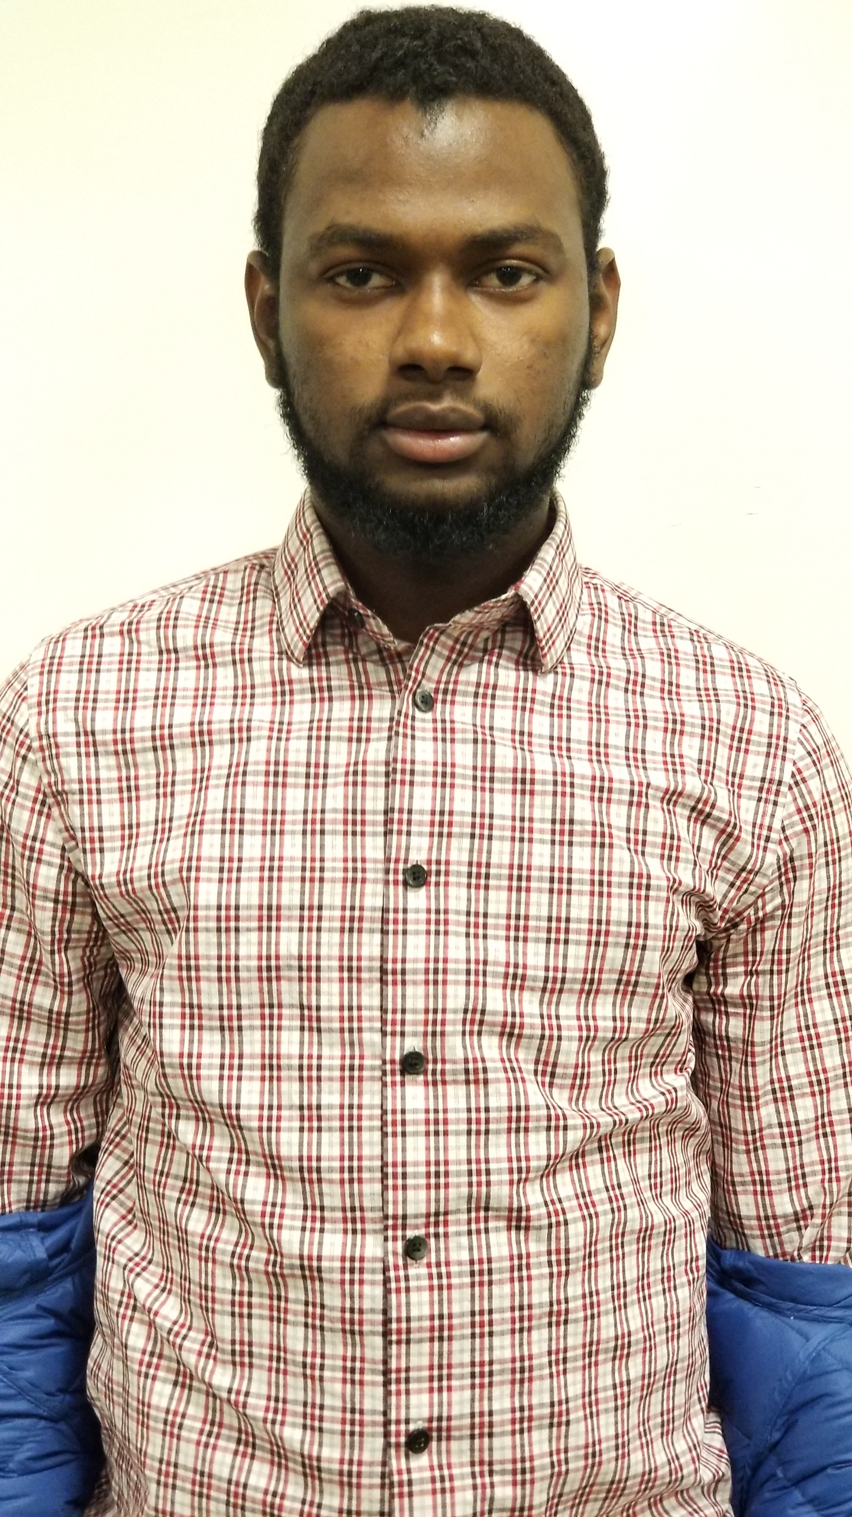
GSA-BMCC E-Board
President Boubacar Bah
Major: Computer Science/Fall 2019 Fun Fact: Work hard, play hard.

Slide 10
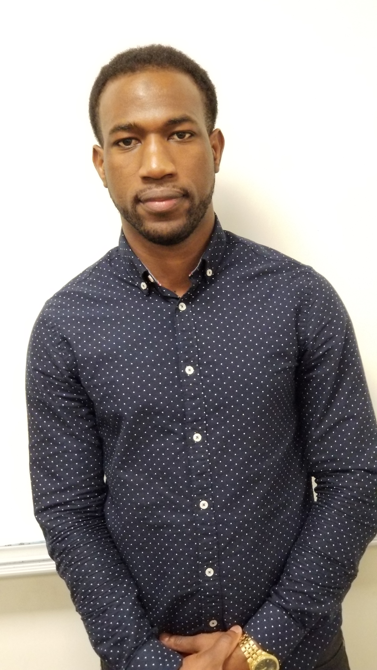
GSA-BMCC E-Board
Vice-President
Mamadou B. Diallo
Major: Computer Information System/ Spring 2020 Fun Fact: Enjoy Coding << >> ;

Slide 11
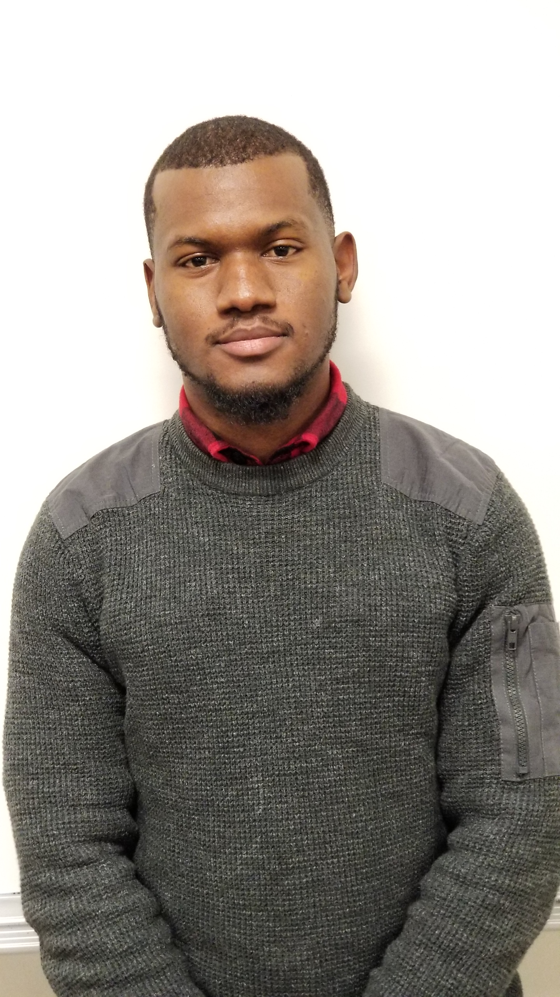
GSA-BMCC E-Board
Secretary Amadou Diallo
Major: Computer Network Technology/Spring 2019 Fun Fact: Enjoy Technology.

Slide 12
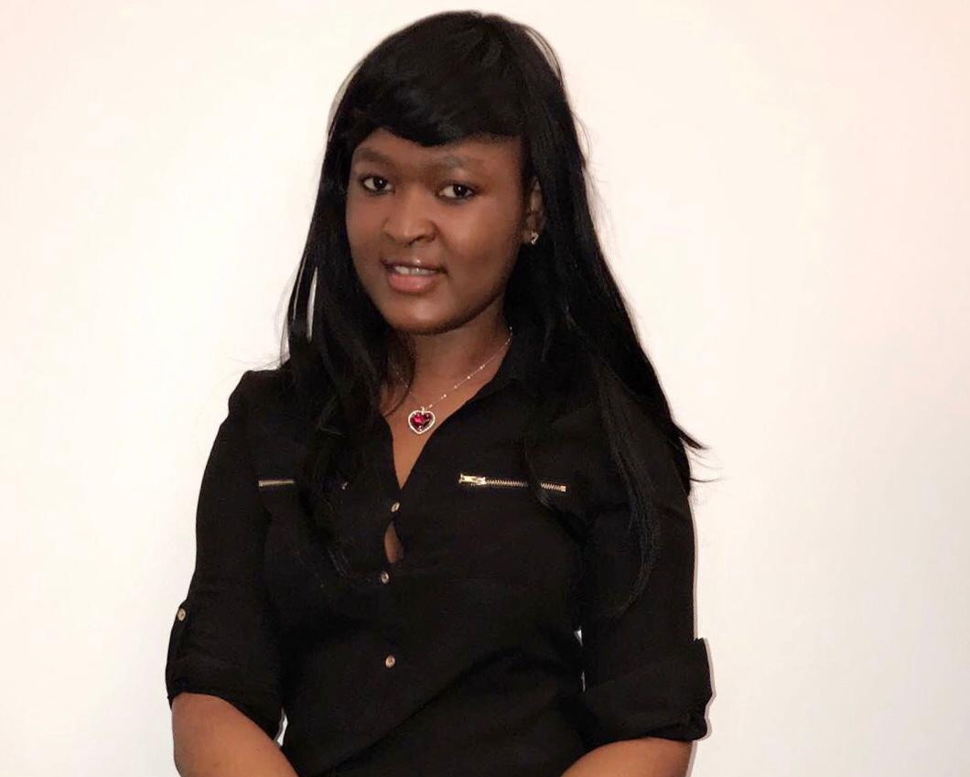
GSA-BMCC E-Board
Treasurer Fatoumata Balde
Major: Business Administration/Spring 2020 Fun Fact: She loves to help others and her dream is to be an entrepreneur.

Slide 13
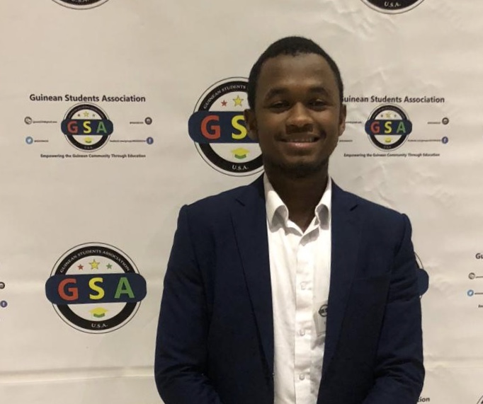
GSA-BMCC E-Board
Chair of Events Planning Mamadou Diallo
Major: Engineering Science /Spring 2020 Fun Fact: His dream is to be a civil engineer, he hopes to contributes in making Guinea a modern society.

Slide 14
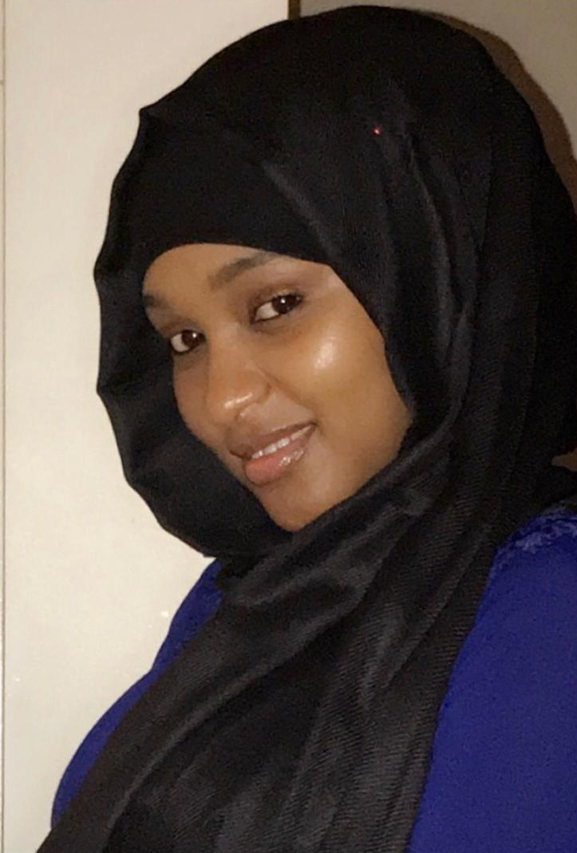
GSA-BMCC E-Board
Chair of Marketing Sona Barry
Major: Liberal Arts/Spring 2019 Fun Fact: Adores Bollywood.

Slide 15
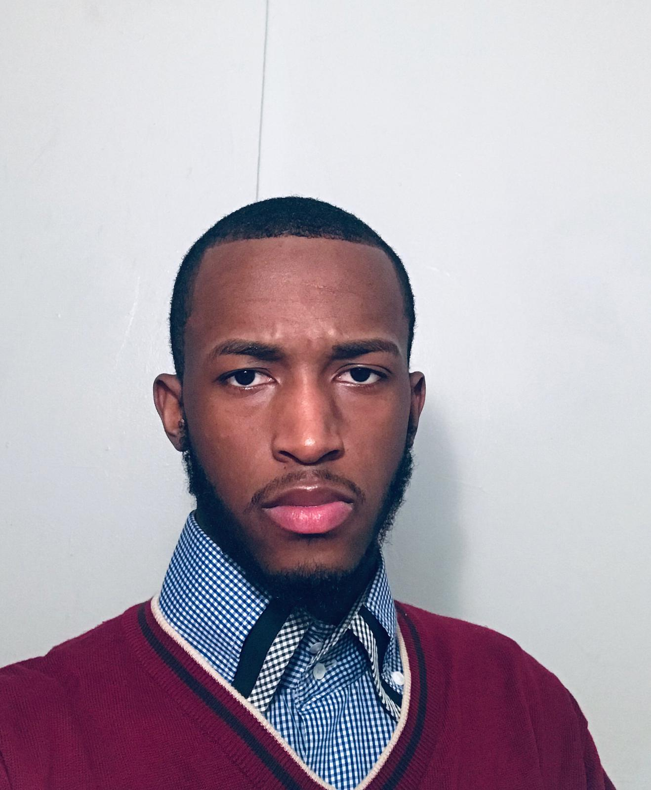
GSA-BMCC E-Board
Vice-Chair of Marketing
Ousmane Diallo
Major: Liberal Arts/Spring 2019
Fun Fact: Sports Enthusiast.

Slide 16
GSA-BMCC E-Board
Chair of Membership
Hassanatou Barry
Major: Liberal Art Science
Fun Fact: Ambitious, and serious about life and love to make others happy

Slide 17
Available Positions
Secretary
Chair of Marketing
Vice Chair of Marketing

Slide 18
Upcoming Events
1.Resume Writing Workshop
2. Cover Letter Writing Workshop
3. Mock Interview and Thank You E-mail Writing Workshop
4. Scholarships/Sponsorships Workshop
5. Workshop about transferring to a 4-year college (the importance of choosing the right college and major)

Slide 19
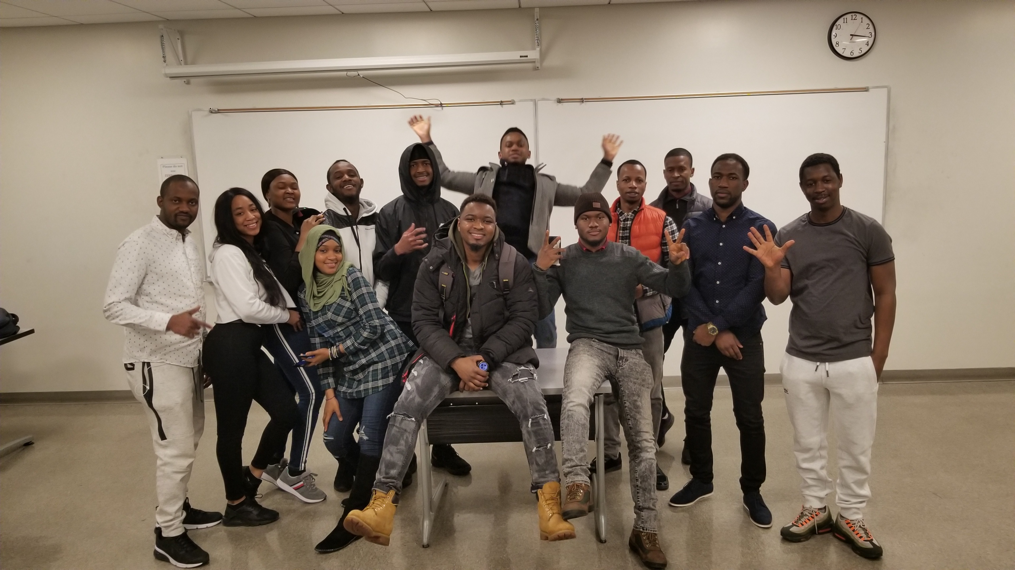
GSA-BMCC Members

Slide 20




Introducing GSA-US and GSA From Other Campuses
GSA-US or Guineans Succeeding in America is the headquarters of all GSA chapters/clubs (Fall 2016)
Upcoming GSA chapters: Lehman College and Georgia Institute of Technology (Atlanta)
GSA all together has over 1000 members nationwide

Slide 21
Short Term/Long Term Goals
Unifying the Guinean community within all CUNY schools
Organize/conduct considerable workshops both on and off campus
Be a guidance for individuals who want to further their education
Create an ongoing organization with resources for the Guinean community to tap into
Appeal to other diversity
Expand nationwide

Slide 22
Accomplishments
Foundation of the Guineans Succeeding in America, headquarters
Members landed internships and Full-time offers with top firms such as: Blackrock, Google, J.P Morgan Chase & Co., MTA, PricewaterhouseCoopers, Wall Street Firm, Research Foundation Cuny etc.
Conducted workshops (Resume, Scholarship, Mock interviews, etc.) across various CUNY schools.
Assisted high school students with their college applications.
Highlighted the importance of joining extracurricular activities both on and off campus.

Slide 23
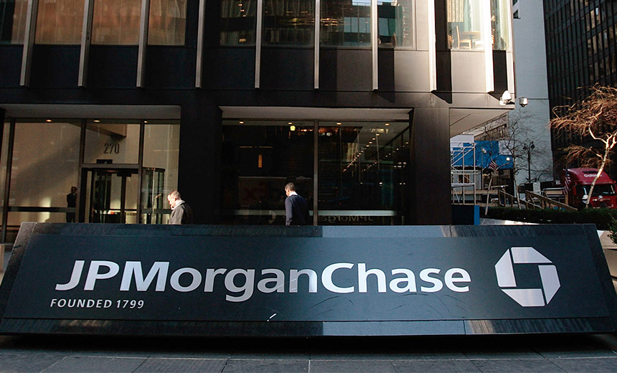



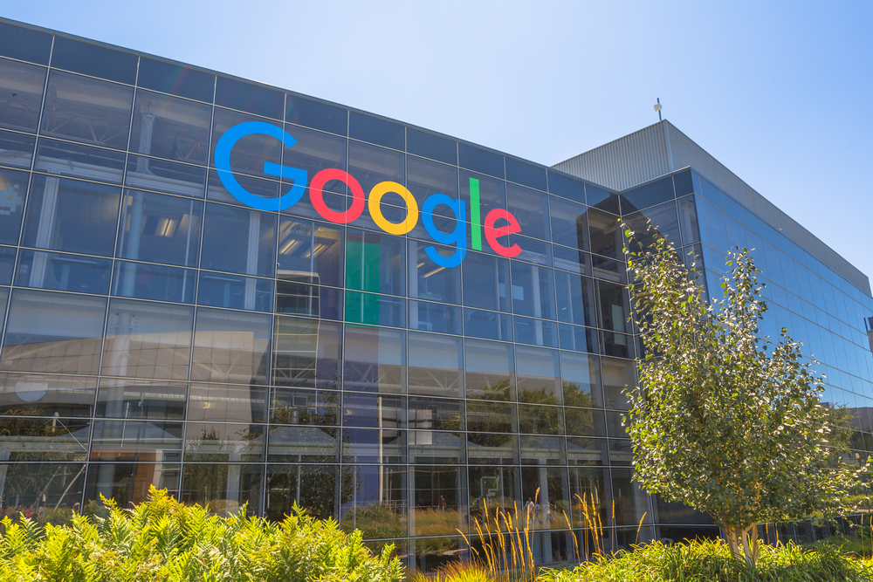
Opportunities

Slide 24
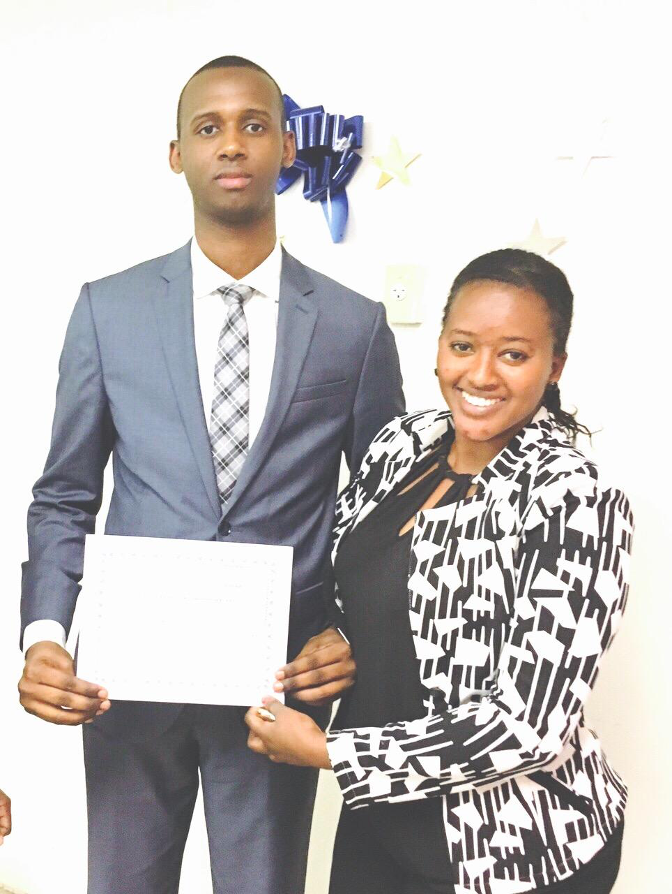
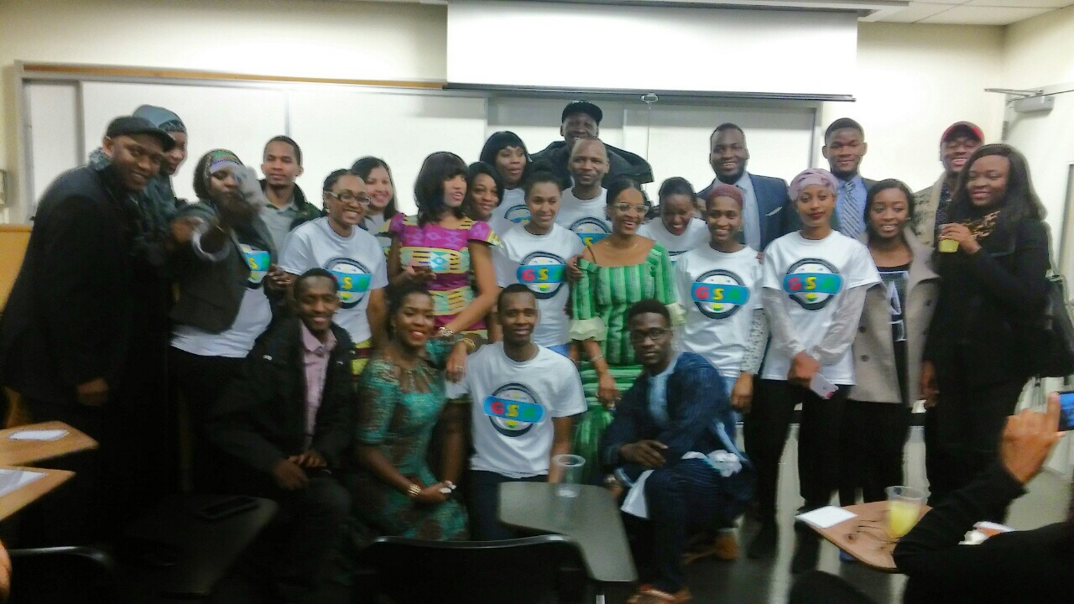
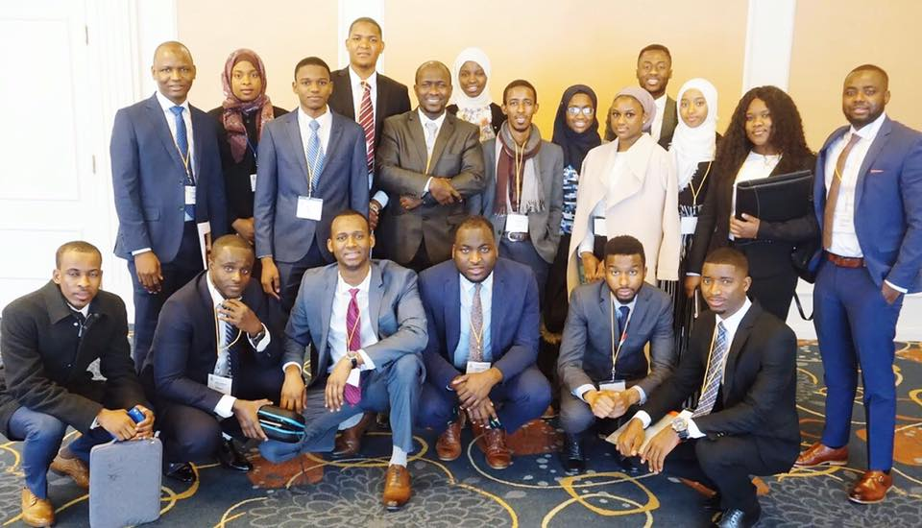
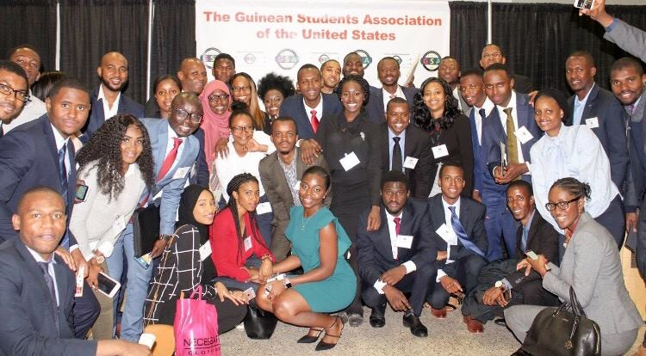
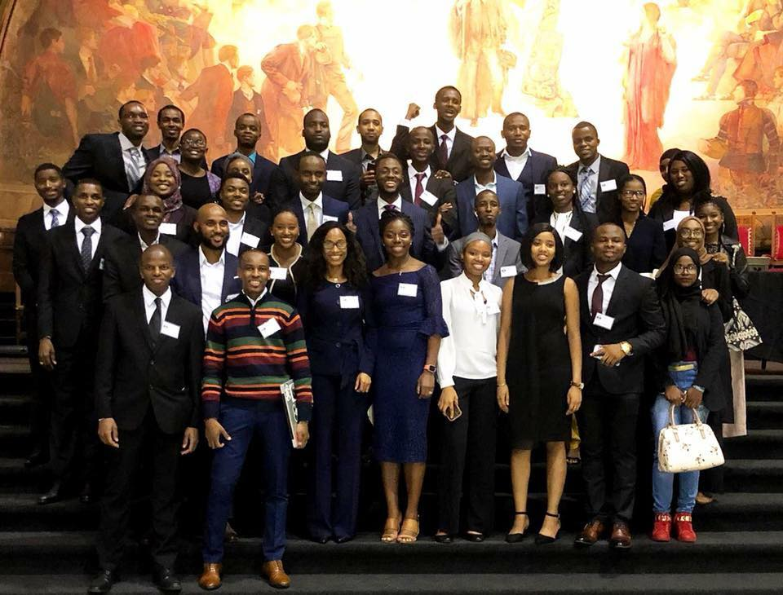
Snapchat of significant moments

Slide 25
Thank you! And Enjoy the rest of your evening
GSA-BMCC
BMCC

